Slide 1
Time Constrained Multi-Agent Path Planning Around Static and Dynamic Obstacles Using Graphs of Convex Sets
Matthew Osburn

Slide 2
Problem Description:
Path planning: Get from point A to point B
Time Constrained: Get from point A to point B in a specific amount of time (no sooner, no later)
Static Obstacles: Don’t hit a wall!
Dynamic Obstacle: don’t hit the moving object!
Multi-Agent: Don’t hit your neighbor, everyone needs to arrive on time.
Our Problem: Do all of these, for all agents.

Slide 3
Problem Visual
A
B

Slide 4
Path Planning
A
B

Slide 5
Time Constrained
t=0 seconds
t= T seconds
A
B

Slide 6
Static Obstacle
Static Obstacle
t=0 seconds
t= T seconds
A
B

Slide 7
Dynamic Obstacle
t=T seconds
Dynamic Obstacle
Static Obstacle
t=0 seconds
t= T seconds
A
B
Dynamic Obstacle
t=0 seconds

Slide 8
Multi-Agent
t=T seconds
t= T seconds
Dynamic Obstacle
B
Static Obstacle
t=0 seconds
t= T seconds
A
B
t=0 seconds
A
Dynamic Obstacle
t=0 seconds

Slide 9
Multi-Agent
t=T seconds
t= T seconds
Dynamic Obstacle
B
Static Obstacle
t=0 seconds
t= T seconds
A
B
t=0 seconds
A
Dynamic Obstacle
t=0 seconds

Slide 10
Method To Solve:
Brute force optimization
How many waypoints are needed?
How do we ensure safety?
Very nonlinear/ multi-modal/ lots of local minima
Made worse by strict time constraint!
Can this decentralize and still ensure safety?
Instead we leverage the geometry of the problem:
Decompose safe space into a graph of convex sets.
Solve graph.
Back out the trajectory from the solved graph.

Slide 11
Related Literature
MIT Papers:
Marcucci, Tobia, Jack Umenberger, Pablo A. Parrilo, and Russ Tedrake. “Shortest Paths in Graphs of Convex Sets.” arXiv, July 3, 2023. http://arxiv.org/abs/2101.11565.
Marcucci, Tobia, Mark Petersen, David Von Wrangel, and Russ Tedrake. “Motion Planning around Obstacles with Convex Optimization.” Science Robotics 8, no. 84 (November 22, 2023): eadf7843. https://doi.org/10.1126/scirobotics.adf7843.
Tordesillas, Jesus, and Jonathan P. How. “MADER: Trajectory Planner in Multiagent and Dynamic Environments.” IEEE Transactions on Robotics 38, no. 1 (February 2022): 463–76. https://doi.org/10.1109/TRO.2021.3080235.

Slide 12
Convex Sets
A convex set is a region/ shape where you can draw a straight line between every combination of two points without leaving the shape:

Slide 13
Graph of Convex Sets Sum Up:

Slide 14
Graph Traversal
B
B
A
A

Slide 15
Research Gap
Graph of convex sets and convex motion planning papers papers have multi-agent interactions, but require very high numbers of dimensions to represent the problem. Time is solved for after original algorithm. Cannot deal effectively with dynamic obstacles, only static ones.
Multi-agent/obstacle avoidance paper presents a method to keep all agents safe from static/dynamic obstacles and other agents. Requires brute force optimizations to guarantee that agents are safe. Somewhat integrates time based solutions, but requires hefty searches.

Slide 16
Contribution
Integrate time as a dimension into the graphs of convex sets to guarantee safety in traversing from point A to point B in a fixed amount of time.
Integrating time into the geometry lowers the dimensionality required with multi-agents and obstacles.
Using the multi-agent method of the last paper guarantees safe sets stay safe.
Claim: Implementing time into the geometry makes dynamic systems fixed, allowing us to apply already developed math techniques to solve the problem.

Slide 17
Algorithm Overview
Break down configuration space into safe convex sets.
Build a graph of the convex sets
Traverse graph
Solve for final trajectory

Slide 18
Convex Configuration Space Algorithm:
MIT approximates their safe sets using an optimization scheme.
I use the binary space partition method to break down space into convex regions.

Slide 19
2D example
Obstacle

Slide 20
2D example
Obstacle

Slide 21
2D example
Obstacle

Slide 22
2D example
Obstacle

Slide 23
2D example
Obstacle

Slide 24
2D example
Obstacle

Slide 25
2D example
H2
H2
H1
H1
H3
H4
H4
H3

Slide 26
3D Implementation
(x, y, t) are configuration space, requiring a 3D spatial representation of the objects.
Requires planar intersections to be calculated
Lots of edge cases arise
Vertex ordering suddenly matters a lot for splitting faces into new faces. Hindsight: limiting faces to 3 vertices (triangles) would have made debugging significantly easier.
This will be left as an exercise for the reader

Slide 27
3D Implementation
(x, y, t) are configuration space, requiring a 3D spatial representation of the objects.
Requires planar intersections to be calculated
Lots of edge cases arise
Vertex ordering suddenly matters a lot for splitting faces into new faces. Hindsight: limiting faces to 3 vertices (triangles) would have made debugging significantly easier.
This will be left as an exercise for the reader
“Abandon all hope, ye who enter”- Dante

Slide 28
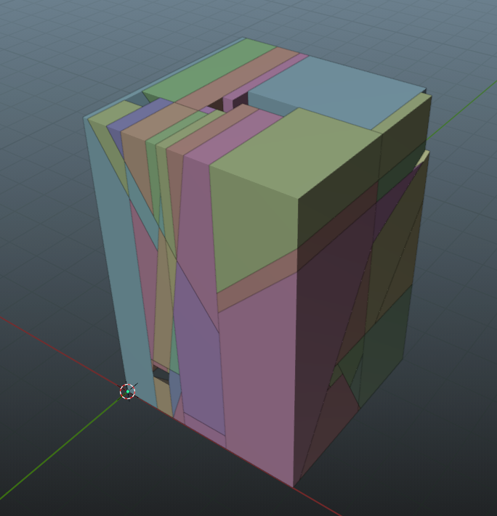
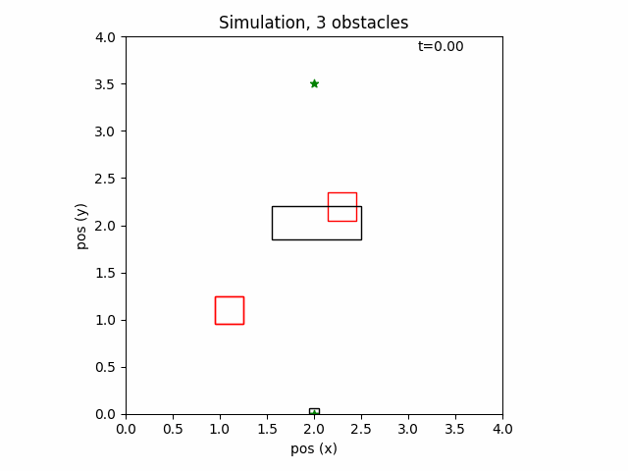
3D Example

Slide 29
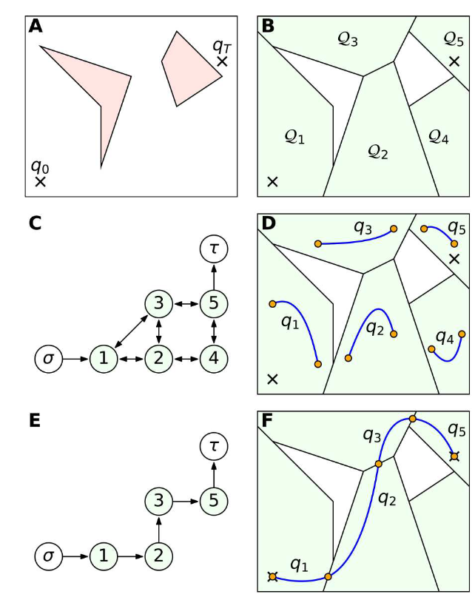
Diverging From MIT
Tried to get MIT’s algorithm to work
Failed to get the graph to optimize in the way indicated in the paper
Needed a presentation, so I took a different route.

Slide 30
A* Graph Traversal
Scores nodes based on 2D distance to solution.
No guarantees path will be feasible with velocity constraints
No guarantees that path won’t double back on itself in time
Failsafe is the final step, which will come back and reject solutions that are non-causal or require extreme velocities.

Slide 31
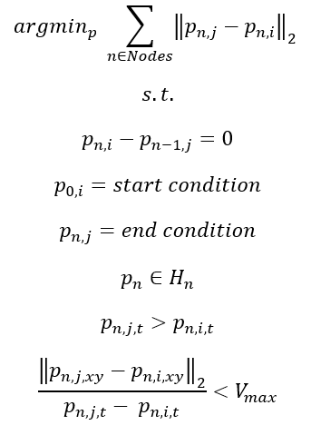
Final Optimization Formulation

Slide 32
Final Optimization Formulation
Sum Internal Path Length of all Nodes

Slide 33
Final Optimization Formulation
Sum Internal Path Length of all Nodes
Starting point of a node connects to previous nodes endpoint

Slide 34
Final Optimization Formulation
Sum Internal Path Length of all Nodes
Starting point of a node connects to previous nodes endpoint
Starting conditions are met
Ending conditions are met

Slide 35
Final Optimization Formulation
Sum Internal Path Length of all Nodes
Starting point of a node connects to previous nodes endpoint
Starting conditions are met
Ending conditions are met
Points have to stay within their respective nodes

Slide 36
Final Optimization Formulation
Sum Internal Path Length of all Nodes
Starting point of a node connects to previous nodes endpoint
Starting conditions are met
Ending conditions are met
Points have to stay within their respective nodes
Points in nodes cannot break causality (no time travel!)

Slide 37
Final Optimization Formulation
Sum Internal Path Length of all Nodes
Starting point of a node connects to previous nodes endpoint
Starting conditions are met
Ending conditions are met
Points have to stay within their respective nodes
Points in nodes cannot break causality (no time travel!)
Velocities can’t exceed max velocity constraint

Slide 38
Multi-Agent Implementation
Agents sort into a priority queue.
I did this arbitrarily
Agent plans route
Once agent plans a route, the shape of his path is re-introduced into the problem.
The space is re-convexified.
Repeat

Slide 39
Stipulations
I didn’t have time to implement splines, so there are straight line paths only.
Infinite accelerations causes sudden jumps in speed
A* does not guarantee the best path, so this is almost always a sub-optimal solution to the path length problem
Mesh breakdown algorithm is one of many ways to solve the problem of getting a convex set. How it breaks down the geometry of the situation greatly effects the solution.

Slide 40
Experiment 1
1 Agent
3 moving obstacles
1 static obstacle
Arrive at the endpoint in 6 seconds

Slide 41
Results!

Slide 42
Multi-Agent Scenario
4 agents
Long Corridor
Reform formation on the other side
T=8
T=9
3
4
3
4
T=0
T=6
T=7
1
2
1
2

Slide 43
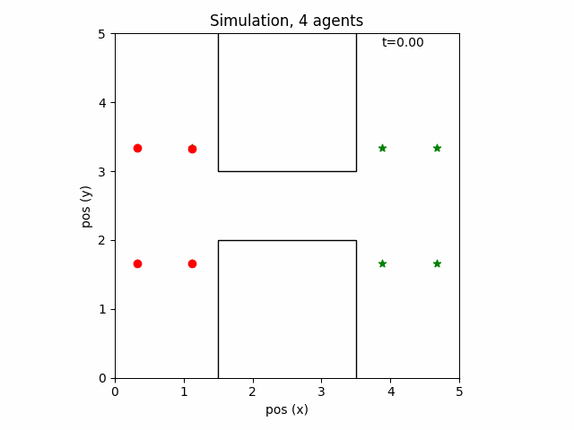
Results

Slide 44
Minkowski Hulls/ Swapped Locations
Actual collision detection for the agents
3
4
3
4
1
2
2
1

Slide 45
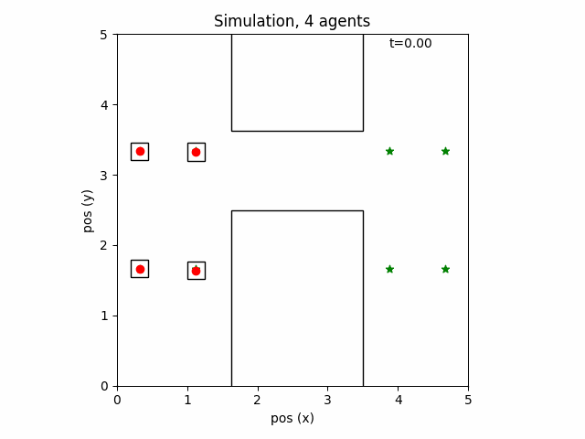
Note: My calculation for the minkowski sum was off, there is *slight* agent overlap

Slide 46

Larger Hulls Still Works

Slide 47

Geometry Idling, Swapped top and bottom

Slide 48

Synchronized Arrival
Overlap still caused by miscalculation of minkowski sums.

Slide 49
Future Work
More lit review, original plan was to build off MIT’s work, had to jump ship on that.
Need to figure out where this fits in the literature.
Splines, dynamic constraints, better graph traversal
Fix Minkowski Sums
Simultaneous agent optimization
Better space convexification
Sparser space = faster compute times
Cartesian aligned = easier integration of graph traversal algorithms
Voronoi partitions guarantee line of sight between centroids of nodes = easier integration of graph traversal algorithms

